Slide 1
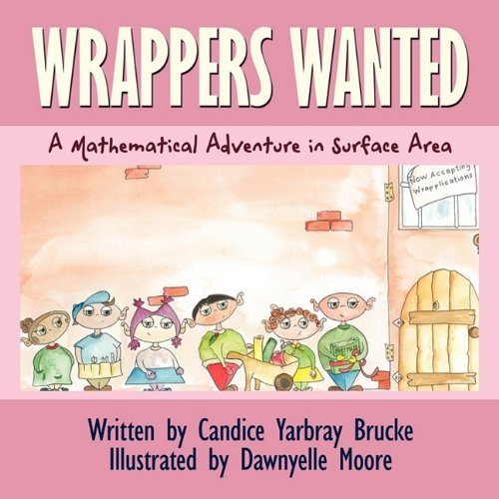
Connecting Literature with Mathematics
Activities Involving Children’s Literature in Middle Grades Math Classes
Presented By Candice Brucke School District of Oconee County –West-Oak Middle School

Slide 2
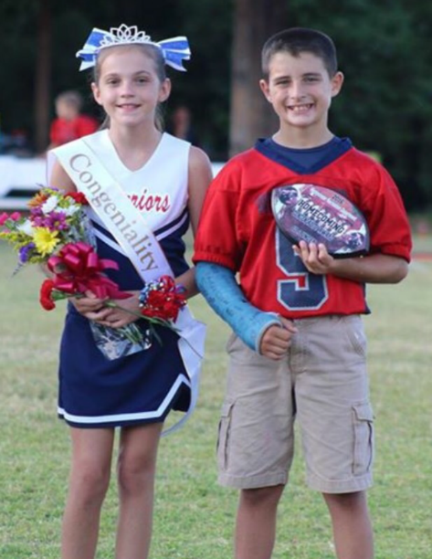
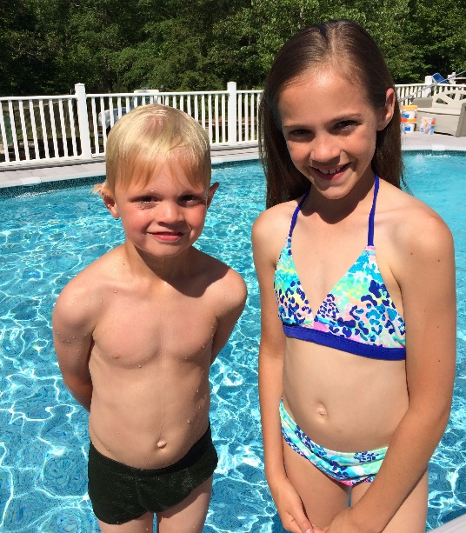
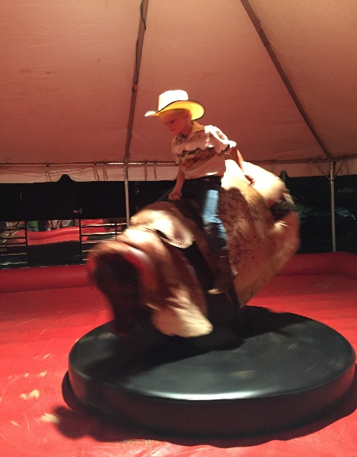
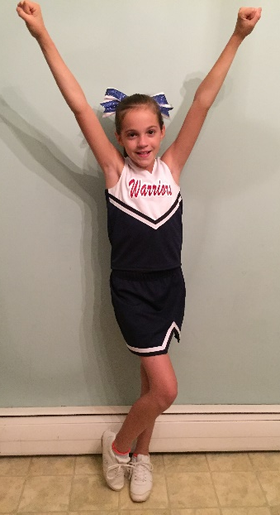
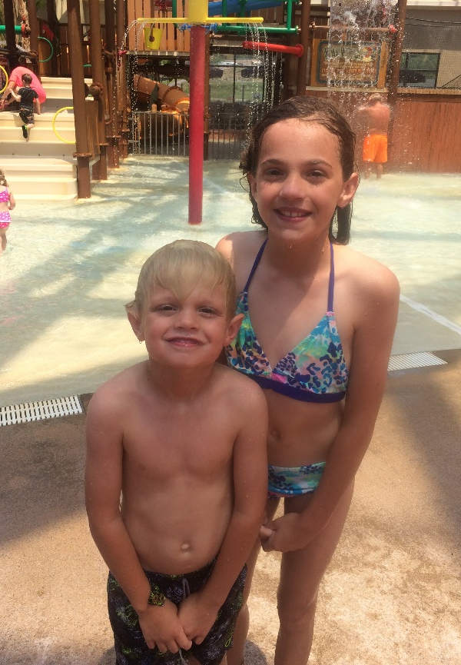
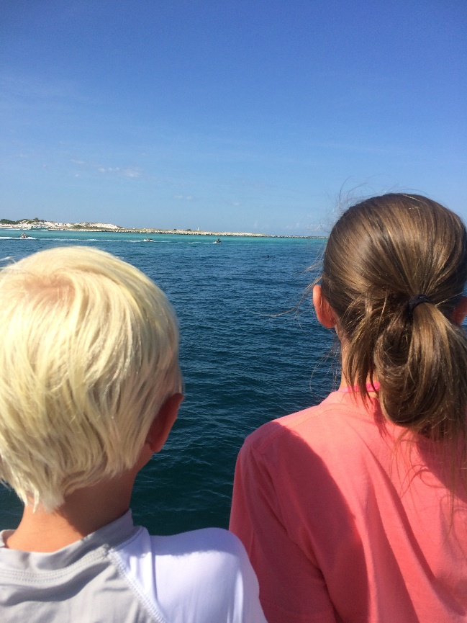
Who is this CANDICE BRUCKE?

Slide 3
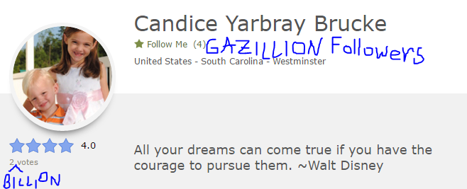
Cinder Edna and Box Plot Activities
Wrappers Wanted Book & Activities
The Day the Crayons Came Home Lesson & Activities
Math of a Princess Story & Activities
My Full Moon is Square Activities
Jim & the Beanstalk Lesson & Activities
Giraffe for France Lesson & Activities
The Phantom Tollbooth Lesson & Activities
List of 100+ books to use in math class FREE on my TPT site!

Slide 4
TODAY’S OJBECTIVE: Learn how to incorporate children’s literature in middle grades math classes and implementing the CCSS.

Slide 5
Surface Area, Area of a Triangle, Area of a Circle
Key Vocabulary: Area
Surface area
Area of a circle Area of a triangle Volume
Squared inches Cubic inches Formula
Net
(6.G.4, 7.G.4)

Slide 6
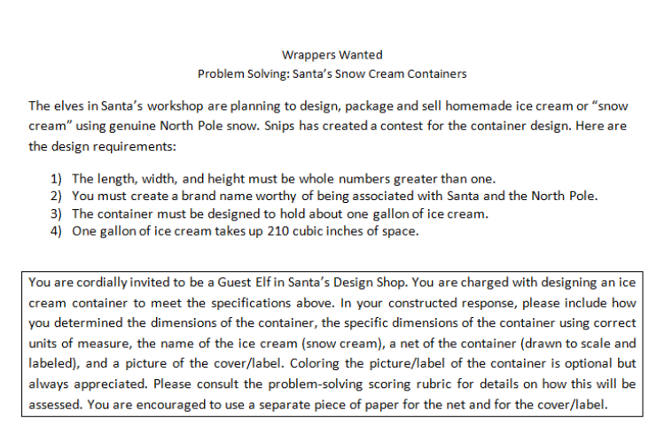

Slide 7
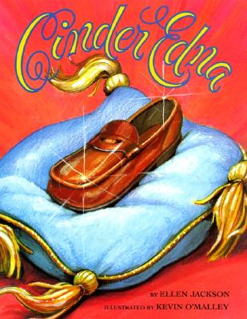
KEEP THE PRINTS!
Determining relationship between height and shoe length
~ scatter plots
Decorated shoe prints ~ box plots
(6.SP.4, 8.SP.1)

Slide 8
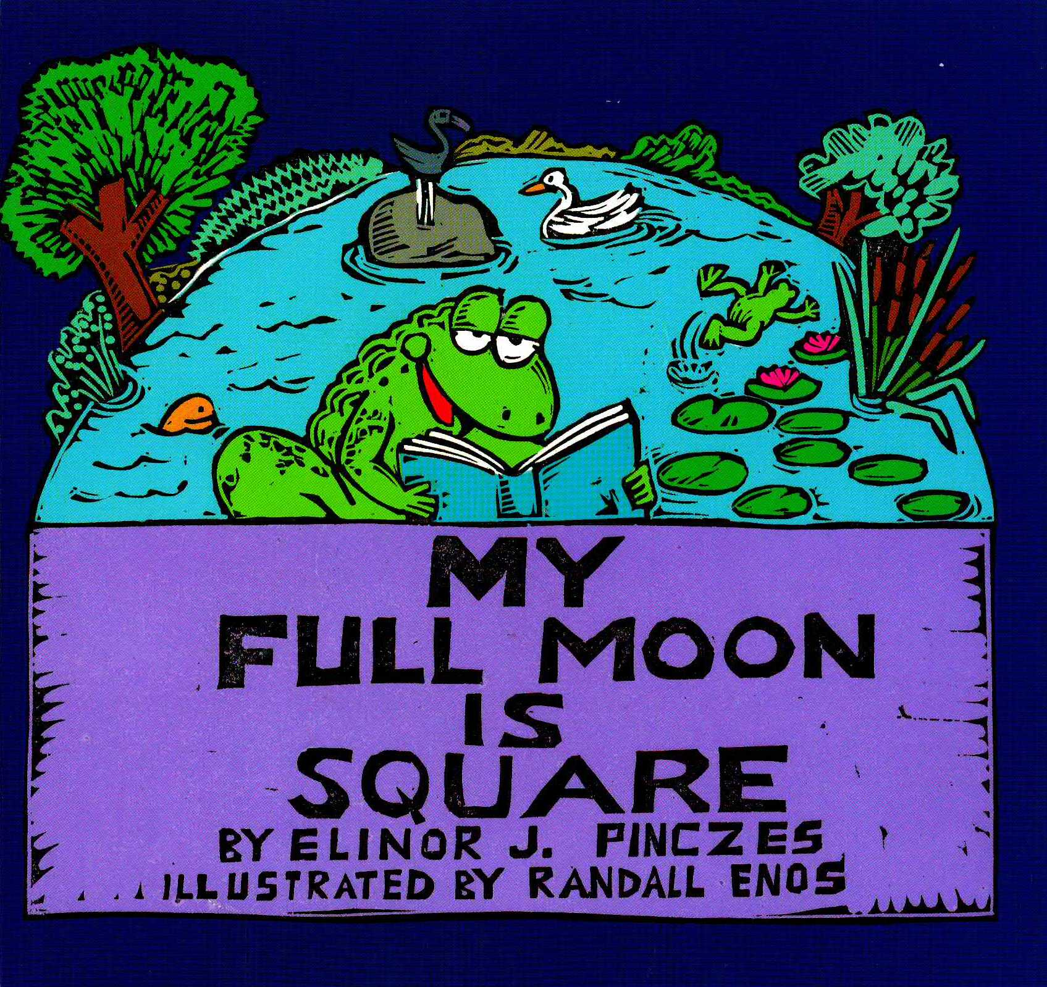
Vivid art work
Colorful
Square numbers
(6.EE.1)

Slide 9
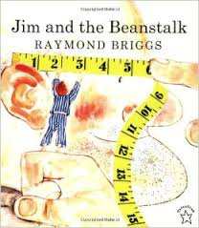
Jim and the Beanstalk is used for proportional reasoning activities.

Slide 10
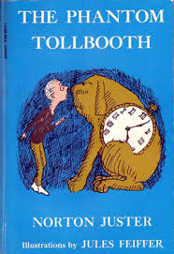
*Integers
*Graphing in the coordinate plane

Slide 11
Solving/Writing Equations
(6.EE.1)

Slide 12
Solving Logic Problems Using

Slide 13
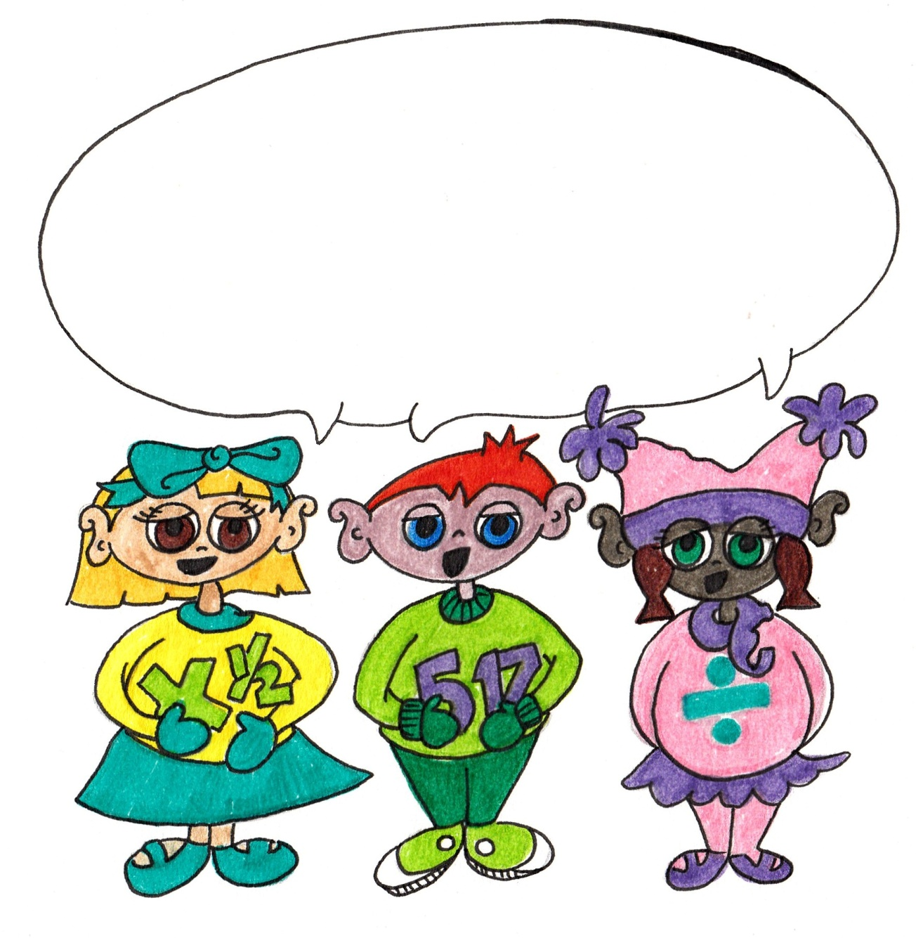
Thanks, y’all!
To check out my Teachers Pay Teachers site for free lesson plans!

